Slide 1
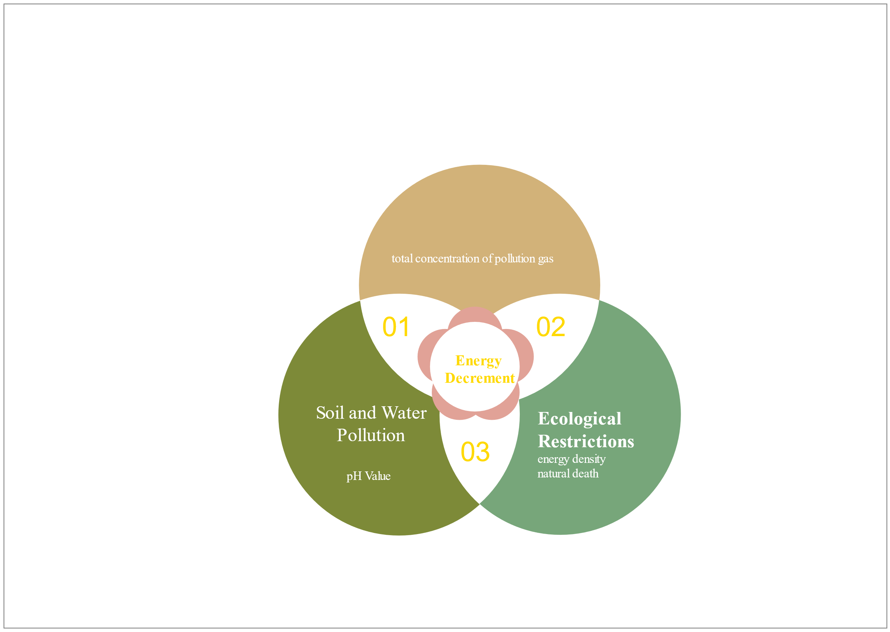
Atmospheric pollution

